Slide 1
CodeAbode
Server Side Integration

Slide 2
Installation

Slide 3
Node Installation
Download installer from https://nodejs.org.

Slide 4
Chrome Plugins Installation
JSON Viewer
POSTMAN

Slide 5
Command Line Tutorial
Change to Directory (CD).
Go back to previous directory (CD..)
List all Directories (ls || dir)
Node Command (node)
Make a new Directory (mkdir)
Create a new File
Windows: cd > filename.extension
Mac: touch filename.extension

Slide 6
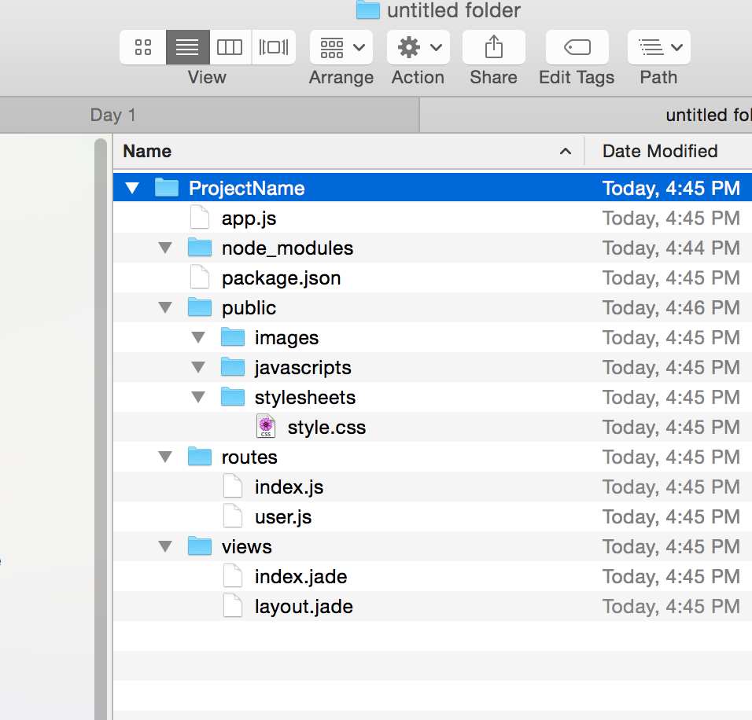
Challenge

Slide 7
Node Installation
Commands should run before next Session
>>node
>>npm
>>express
>>nodemon
>>dir or ls
>> cd..
>> mkdir
>> curl (http://callejoabel.blogspot.com/2013/09/making-curl-work-on-windows-7.html)

Slide 8
Client Side JavaScript
Browser is not allowed. You have to use command
>>node file.js
to run your JavaScript file(unless specified).

Slide 9
Applications of Node.js
WebSocket Server.
Like a chat Server
File Upload Client (non blocking way: more than one file).
More than one file at a time
Ad Server.
Serving 100s of ads based on user.
Any Real Time Data apps

